Slide 1

Go, change the world
RV College of
Engineering
Design and Analysis of
Analog and Digital Circuits
Summer Internship Phase I Presentation
Student Name: Pavan Kumar C Banasode (1RV21EC116)
Guide Name: Dr. Shilpa D R
Designation: Associate Professor
Department of Electronics and Communication Engineering
*
Department of ECE
1

Slide 2

Go, change the world
RV College of
Engineering
Outline
Profile of the organization
Activities of the organization
Tasks performed (in detail)
Outcome of internship
*
Department of ECE
2

Slide 3
Go, change the world
RV College of
Engineering
Internship offer letter / Certificate of completion of internship (with name and duration of internship)
YET TO RECEIVE FROM COE-CICS
*
Department of ECE
3

Slide 4
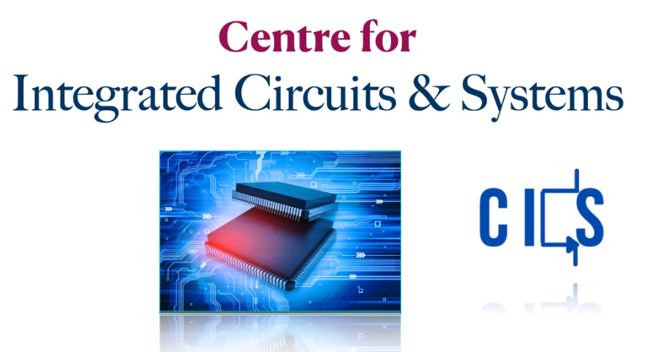
Go, change the world
RV College of
Engineering
Profile of the organization
Centre for Integrated Circuit and Systems is a Centre of Excellence at RVCE, Bengaluru.
Work on Analog Design, Digital Design, Mixed Signal Design and RF Design
*
Department of ECE
4

Slide 5
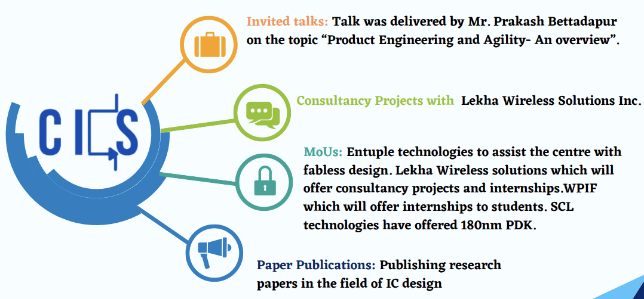
Go, change the world
RV College of
Engineering
Activities of the organization
Provide internship to undergraduate and postgraduate students
Invited talks, consultancy projects with Lekha Wireless Solutions Inc.
MoUs with several leading tech companies
Paper publications in the field of IC design
Image source: https://rvce.edu.in/sites/default/files/RVCE-CoE-Brochure.pdf
*
Department of ECE
5

Slide 6
Go, change the world
RV College of
Engineering
Tasks performed during internship
Analysis of RLC networks
Workshop on LTSpice simulation software.
Analysis and simulation of analog and digital circuits in LTSpice software.
Introduction to Verilog.
Weekly assignments based on the conducted classes.
Webinar on MOSFET Fabrication addressed by Ms. Sabiha Sultana, Prof., IISc.
Visit to IDRC Lab.
Team project to design RC Coupled Amplifier.
*
Department of ECE
6

Slide 7
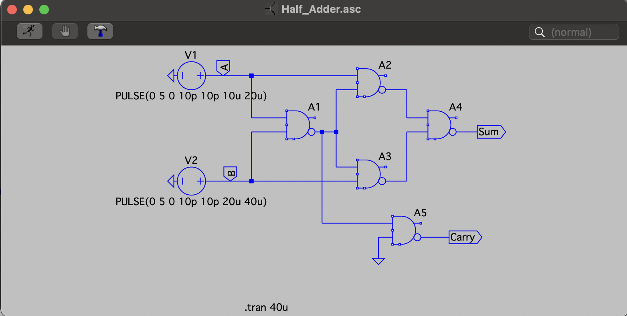
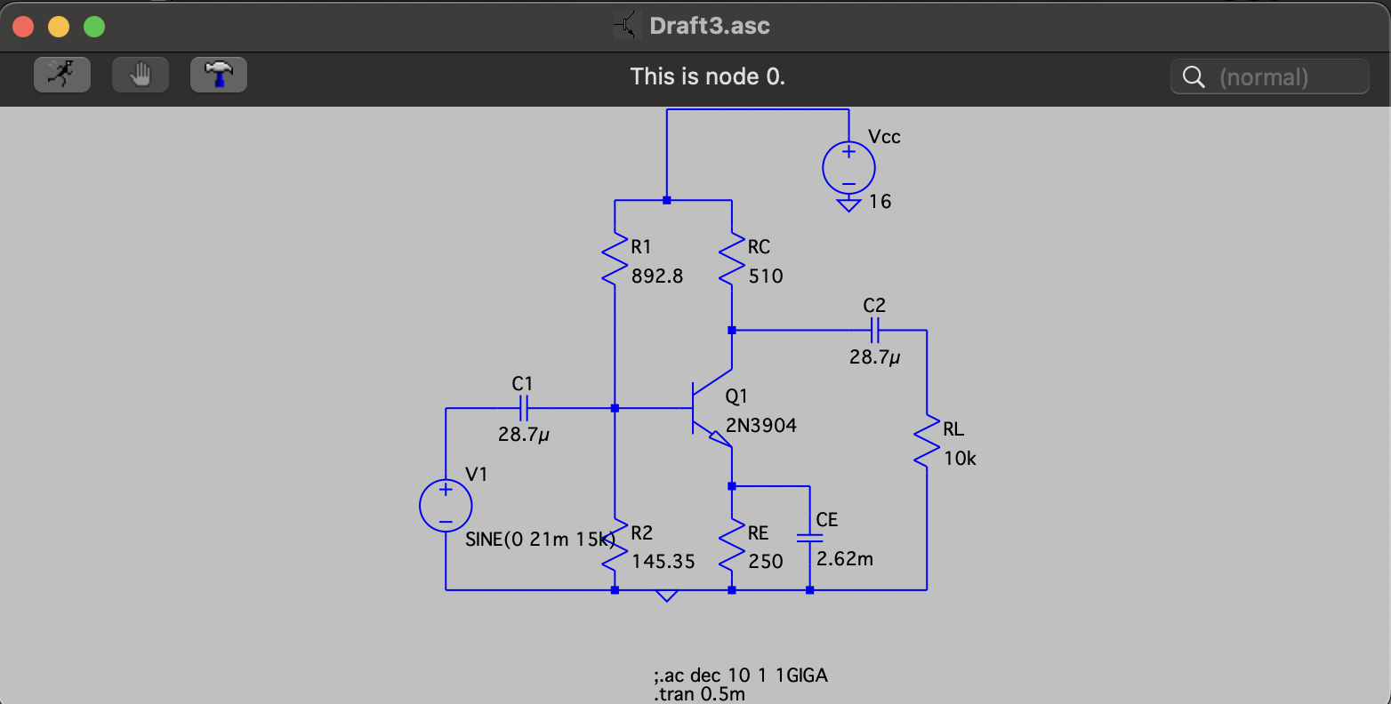
Go, change the world
RV College of
Engineering
Design and Analysis of Analog and Digital Circuits using LTSpice
*
Department of ECE
7

Slide 8
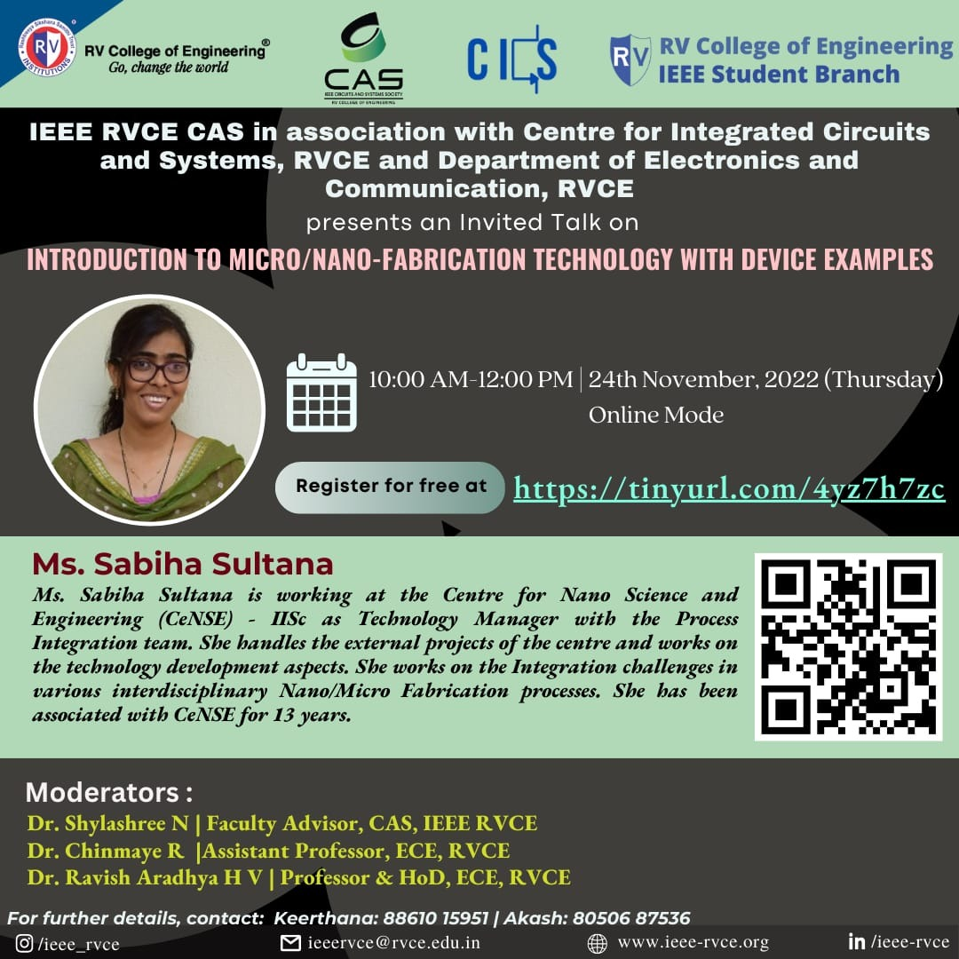
Go, change the world
RV College of
Engineering
Webinar on Fabrication Technology, by Ms.Sabiha Sulthana
*
Department of ECE
8

Slide 9
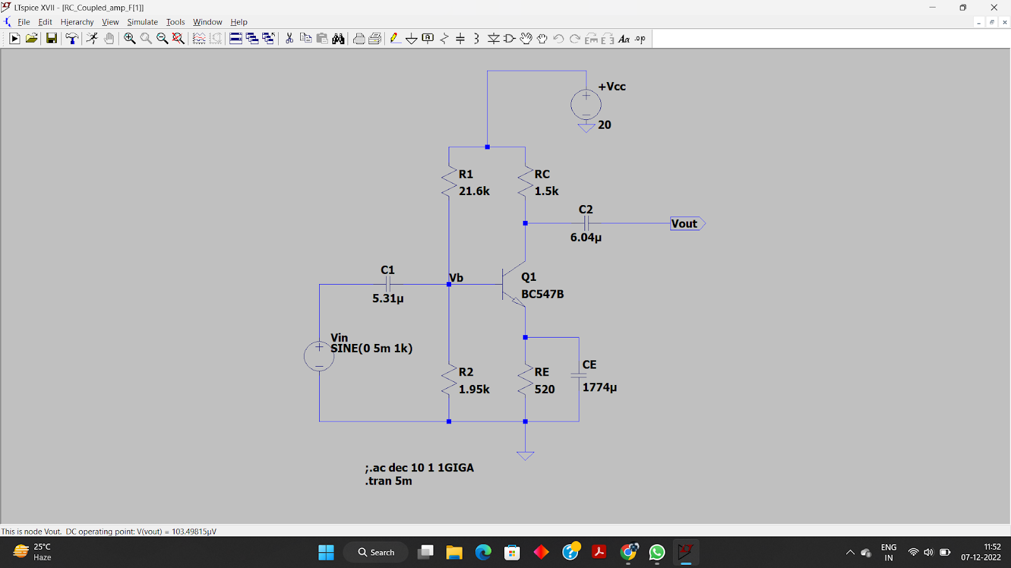
Go, change the world
RV College of
Engineering
Team project to design RC Coupled Amplifier
*
Department of ECE
9

Slide 10
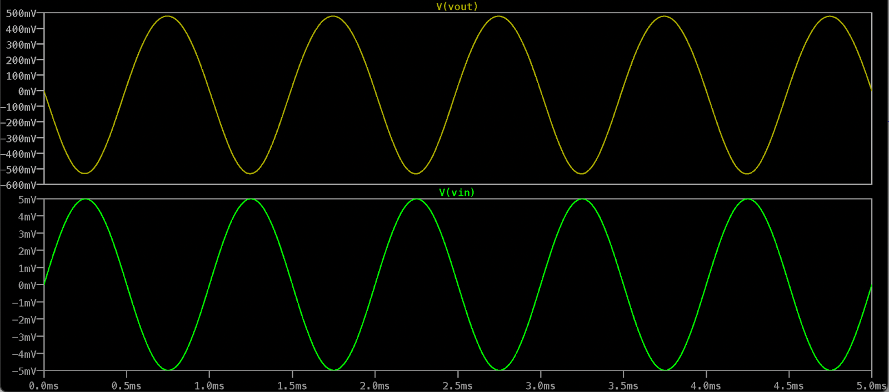
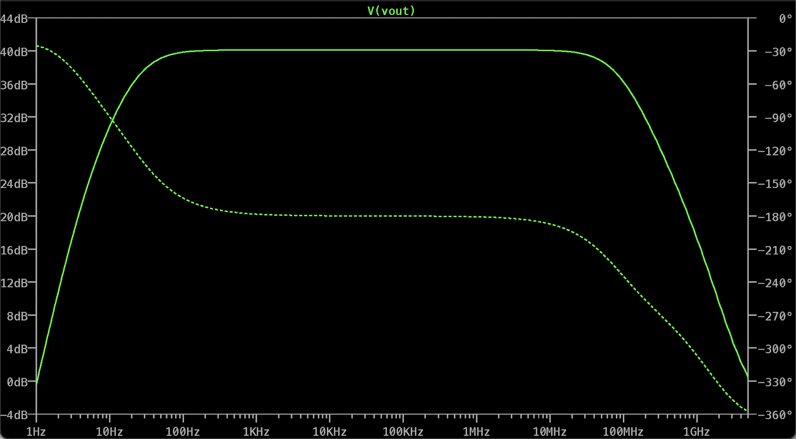
Go, change the world
RV College of
Engineering
Team project to design RC Coupled Amplifier
*
Department of ECE
10

Slide 11
Go, change the world
RV College of
Engineering
Outcome of the Internship
LTSpice simulation software
Fundamentals of Digital design / Verilog
Fundamentals of analog design
Designing of RC Coupled Amplifier using BJT
*
Department of ECE
11

Slide 12
Go, change the world
RV College of
Engineering
Thank You
*
Department of ECE
12

